Slide 1
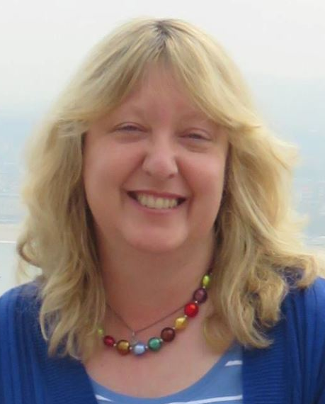
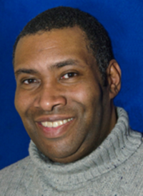
1 in 30?
Autism and Inclusion
in Churches.
Ann Memmott &
Dean Pusey

Slide 2
Who are your trainers?
Ann Memmott PGC
Director, AT-Autism & Trustee, Autistic Pride Reading
Author of the main CofE guidelines on autism & trainer for DDO teams.
Autistic. Disabled.
Non-verbal for first ten years, gradually learned to speak.
Dean Pusey
Parent/Carer of actually-autistic child, Diocesan Youth Officer, Trustee, South Londoner born and nurtured, now visitor!

Slide 3
Outline of Session - All timings approximate
7.20-7.50 Ground Rules.
Ann: What is autism?
Why is inclusion of autistic people important?
7.50 to 8.10 Dean: Journeys of this parent/carer. Life and Faith.
8.10 – 8.30 Workshop groups
8.30 - 8.45 Sharing and questions

Slide 4

What is Autism?
Neurodiversity
About 1 in every 30 people of every age, intelligence and background.
Male and female
1 in 30 of our current church leaders?
Has strengths as well as differences
Two of these?

Slide 5
Four Main Things: Generalising
Routine.
Different social communication system.
Sensory differences – sight, sound, smell, taste, touch, balance, heat, cold.
Many be very literal.….

Slide 6
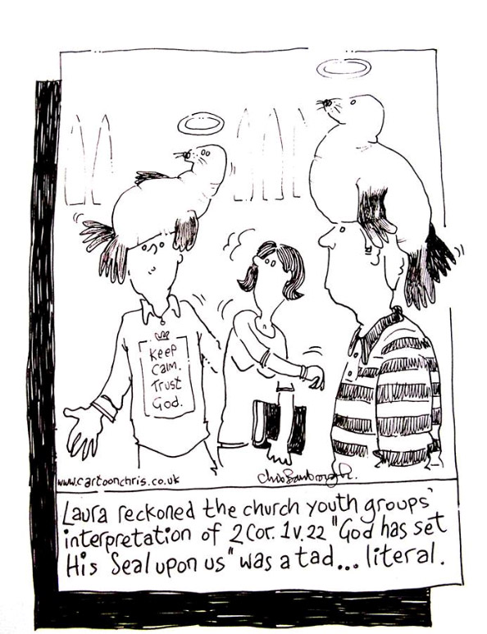
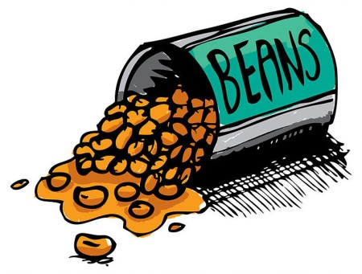
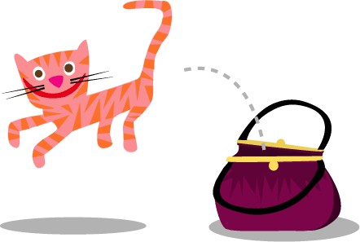
“Don’t spill the beans”
“Gosh, that let the cat out of the bag!”

Slide 7
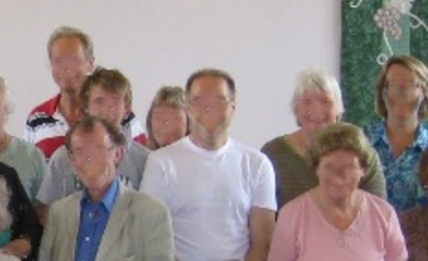
Some are faceblind too (I am). Maybe we don’t know it’s you. Others see faces extremely well.
We learn the workarounds; height, build, hair colour, glasses, clothing style, voice.

Slide 8
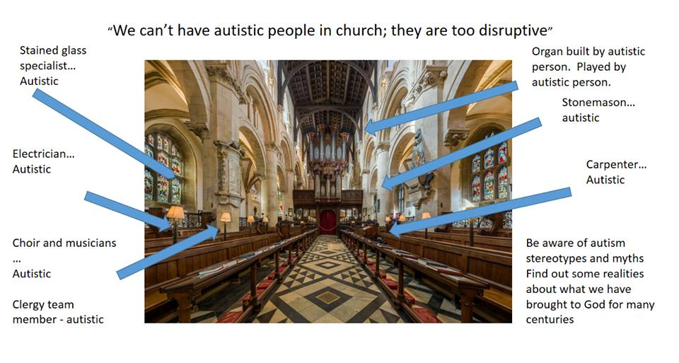
Mythbuster

Slide 9


Positives
Extremely honest, loyal, persistent, not afraid to point out injustice, very keen on fairness. Amazing concentration skills. Some have excellent memories and abilities.
Prayer partners. Friends. All loved by God. As likely to be Christian as anyone else.
Some fantastic church leaders are autistic. They may not tell you this.

Slide 10
Autism in the Bible?
Nicodemus.
Autistic?
Arrives in quiet of evening.
Specialist Jewish leader with deep knowledge of law.
Misunderstands metaphor.
Reaches for a rule book.
Staggers up a hill with an imponderable amount of herbs and spices, rather than the socially-usual-handfuls.
Still autistic. Not cured. Still loyal. Still a friend and helper of Jesus.

Slide 11
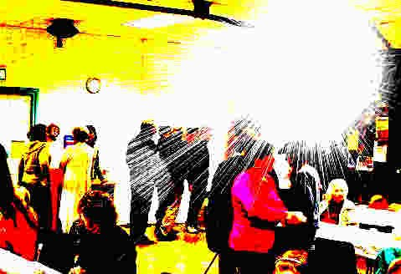
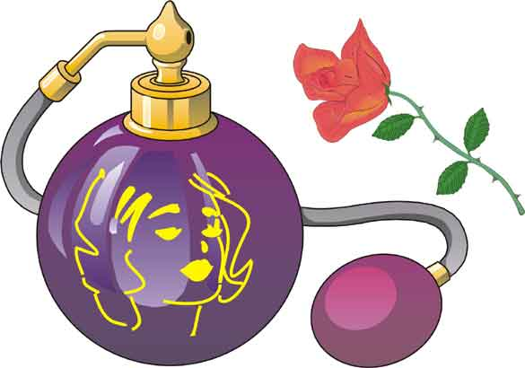
Different sensory system
Busy, noisy places can be blinding and deafening.
Not ‘challenging behaviour’. Distress from sensory overload.

Slide 12
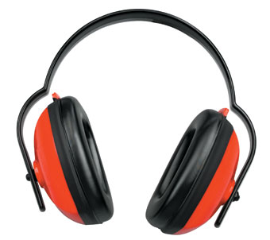
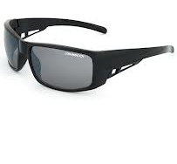
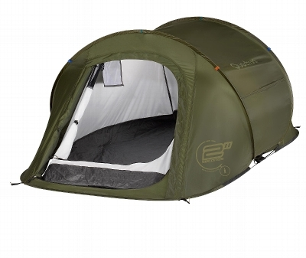
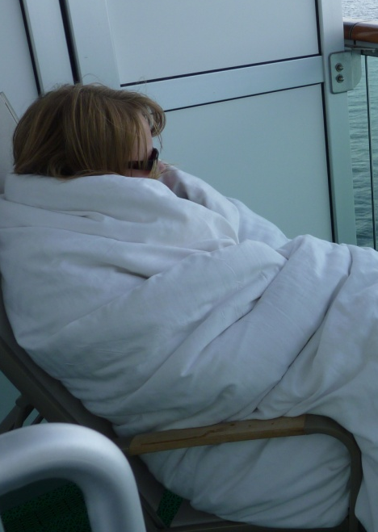
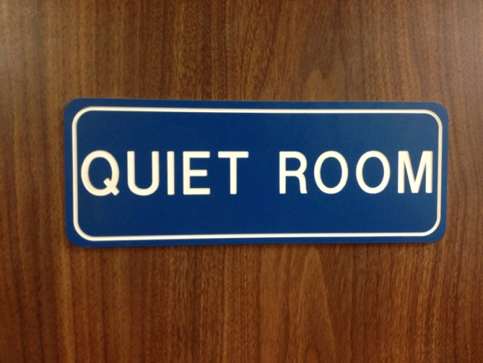
How do I Escape Sensory or Social Overload Pain?

Slide 13
Dean Pusey
The journey so far
  Home
  School
  Church
  Community

Slide 14
Break into groups. 20 minutes.

Slide 15


More info?
Guidelines - Diocese of Oxford website – search for disability or autism
A2ndVoice
https://www.a2ndvoice.com/
Lynn McCann https://www.reachoutasc.com/churches-organisations

Slide 16
Questions and
Thank you
Dean Pusey and Ann Memmott

